Slide 1
CS101 Introduction to Computing
Lecture 7
Microprocessors

Slide 2
The last lecture, Lec 6, was on Web dev. Today’s lecture, however, is a follow-up to Lec 5
In lecture 5, we looked at the components that we bring together to form a PC
We looked at ports, power supply, mother board, add-on cards (modem, LAN, video), memory, hard disk, floppy disk, CD, and the microprocessor and the associated cooling apparatus
Today our focus will be on one of those components, the microprocessor

Slide 3
Goals for Today
Today we want to learn about the microprocessor, the key component, the brain, of a computer
We’ll learn about the function of a microprocessor
And its various sub-systems
  Bus interface unit]
  Data & instruction cache memory
  Instruction decoder
  Arithmetic-Logic unit
  Floating-point unit
  Control unit

Slide 4
Microprocessor
The key element of all computers, providing the mathematical and decision making ability
Current state-of-the-art uPs (Pentium, Athlon, SPARC, PowerPC) contain complex circuits consisting of tens of millions of transistors
They operate at ultra-fast speeds – doing over a billion operations very second
Made up from a semiconductor, Silicon

Slide 5
Integrated Circuits
Commonly known as an IC or a chip
A tiny piece of Silicon that has several electronic parts on it
Most of the size of an IC comes form the pins and packaging; the actual Silicon occupies a very small piece of the volume
The smallest components on an IC are much smaller than the thickness of a human hair

Slide 6
Those components are …
Devices
  Transistors
  Diodes
  Resistors
  Capacitors
  Wires
And are made of the following materials
  Silicon - semiconductor
  Copper - conductor
  Silicon Dioxide - insulator

Slide 7
A microprocessor system?
uPs are powerful pieces of hardware, but not much useful on their own
Just as the human brain needs hands, feet, eyes, ears, mouth to be useful; so does the uP
A uP system is uP plus all the components it requires to do a certain task
A microcomputer is 1 example of a uP system

Slide 8
Micro-controllers?
Micro-controllers are another type of uP systems
They are generally not that powerful, cost a few dollars a piece, and are found embedded in video games, VCRs, microwave ovens, printers, autos, etc.
They are a complete computer on a chip containing direct input and output capability and memory along with the uP on a single chip. Many times they contain other specialized application-specific components as well

Slide 9
QUESTION:
Why do we ever build just uPs?
Why not just build micro-controllers that contain everything on chip?
Post your answers on the CS101 message board

Slide 10
More than 90% of the microprocessors/micro-controllers manufactured are used in embedded computing applications
In 2000 alone, 365 million uPs and 6.4 billion micro-controllers were manufactured

Slide 11
The Main Memory Bottleneck
Modern super-fast uPs can process a huge amount of data in a short duration
They require quick access to data to maximize their performance
If they don’t receive the data that they require, they literally stop and wait – this results in reduced performance and wasted power
Current uPs can process an instruction in about a ns. Time required for fetching data from main memory (RAM) is of the order of 100 ns

Slide 12
Solution to the Bottleneck Problem
Make the main memory faster
Problem with that approach: The 1-ns memory is extremely expensive as compared the currently popular 100-ns memory
Another solution: In addition to the relatively slow main memory, put a small amount of ultra-fast RAM right next to the uP on the same chip and make sure that frequently used data and instructions resides in that ultra-fast memory
Advantage: Much better overall performance due to fast access to frequently-used data and instructions

Slide 13
On-Chip Cache Memory (1)
That small amount of memory located on the same chip as the uP is called On-Chip Cache Memory
The uP stores a copy of frequently used data and instructions in its cache memory
When the uP desires to look at a piece of data, it checks in the cache first. If it is not there, only then the uP asks for the same from the main memory

Slide 14
On-Chip Cache Memory (2)
The small size and proximity to the uP makes access times short, resulting in a boost in performance (it is easy to find things in a small box placed next to you)
uPs predict what data will be required for future calculations and pre-fetches that data and places it in the cache so that it is available immediately when the need arises
The speed-advantage of cache memory is greatly dependent on the algorithm used for deciding about what to put in cache or not

Slide 15
uP Building Blocks

Slide 16
Microprocessor
Data
Cache
Memory
Bus
Control
Unit
Arithmetic
& Logic
Unit
RAM
Bus
Interface
Unit
I/O
Instruction
Decoder
Registers
System
Bus
Floating
Point
Unit
Instruction
Cache
Registers

Slide 17
Bus Interface Unit
Receives instructions & data from main memory
Instructions are then sent to the instruction cache, data to the data cache
Also receives the processed data and sends it to the main memory

Slide 18
Instruction Decoder
This unit receives the programming instructions and decodes them into a form that is understandable by the processing units, i.e. the ALU or FPU
Then, it passes on the decoded instruction to the ALU or FPU

Slide 19
Arithmetic & Logic Unit (ALU)
Also known as the “Integer Unit”
It performs whole-number math calculations (subtract, multiply, divide, etc) comparisons (is greater than, is smaller than, etc.) and logical operations (NOT, OR, AND, etc)
The new breed of popular uPs have not one but two almost identical ALU’s that can do calculations simultaneously, doubling the capability

Slide 20
Floating-Point Unit (FPU)
Also known as the “Numeric Unit”
It performs calculations that involve numbers represented in the scientific notation (also known as floating-point numbers).
This notation can represent extremely small and extremely large numbers in a compact form
Floating-point calculations are required for doing graphics, engineering and scientific work
The ALU can do these calculations as well, but will do them very slowly

Slide 21
Registers
Both ALU & FPU have a very small amount of super-fast private memory placed right next to them for their exclusive use. These are called registers
The ALU & FPU store intermediate and final results from their calculations in these registers
Processed data goes back to the data cache and then to main memory from these registers

Slide 22
Control Unit
The brain of the uP
Manages the whole uP
Tasks include fetching instructions & data, storing data, managing input/output devices

Slide 23
Microprocessor
Data
Cache
Memory
Bus
Control
Unit
Arithmetic
& Logic
Unit
RAM
Bus
Interface
Unit
I/O
Instruction
Decoder
Registers
System
Bus
Floating
Point
Unit
Instruction
Cache
Registers

Slide 24
That was the structure, now let’s talk about the language of a uP

Slide 25
Instruction Set
The set of machine instructions that a uP recognizes and can execute – the only language uP knows
An instruction set includes low-level, a single step-at-a-time instructions, such as add, subtract, multiply, and divide
Each uP family has its unique instruction set
Bigger instruction-sets mean more complex chips (higher costs, reduced efficiency), but shorter programs

Slide 26
The 1st uP: Intel 4004
Introduced 1971
2250 transistors
108 kHz, 60,000 ops/sec
16 pins
10-micron process
As powerful as the ENIAC which had 18000 tubes and occupied a large room
Targeted use: Calculators
Cost: less than $100

Slide 27
Why Intel came up with the idea?
A Japanese calculator manufacturer – Busicom – wanted Intel to develop 16 separate IC’s for a line of new calculators
Intel, at that point in time known only as a memory manufacturer, was quite small and did not have the resources to do all 16 chips
Ted Hoff came up with the idea of doing all 16 on a single chip
Later, Intel realized that the 4004 could have other uses as well

Slide 28
Currently Popular – Intel Pentium 4 (2.2GHz)
Introduced December 2001
55 million transistors
32-bit word size
2 ALU’s, each working at 4.4GHz
128-bit FPU
0.13 micron process
Targeted use: PC’s and low-end workstations
Cost: around $600

Slide 29
Moore’s Law
In 1965, one of the founders of Intel – Gordon Moore – predicted that the number of transistor on an IC (and therefore the capability of microprocessors) will double every year. Later he modified it to 18-months
His prediction still holds true in ‘02. In fact, the time required for doubling is contracting to the original prediction, and is closer to a year now

Slide 30
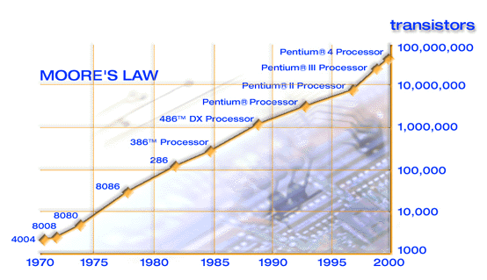
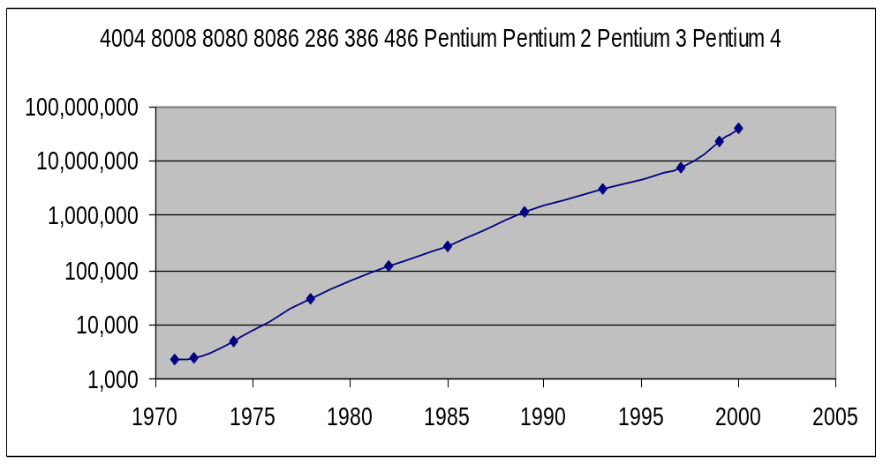
Evolution of Intel Microprocessors

Slide 31
4-, 8-, 16-, 32-, 64-bit (Word Length)
The 4004 dealt with data in chunks of 4-bits at a time
Pentium 4 deals with data in chunks (words) of 32-bit length
The new Itanium processor deals with 64-bit chunks (words) at a time
Why have more bits (longer words)?

Slide 32
kHz, MHz, GHz (Clock Frequency)
4004 worked at a clock frequency of 108kHz
The latest processors have clock freqs. in GHz
Out of 2 uPs having similar designs, one with higher clock frequency will be more powerful
Same is not true for 2 uPs of dissimilar designs. Example: Out of PowerPC & Pentium 4 uPs working at the same freq, the former performs better due to superior design. Same for the Athlon uP when compared with a Pentium

Slide 33
Enhancing the capability of a uP?
The computing capability of a uP can be enhanced in many different ways:
  By increasing the clock frequency
  By increasing the word-width
  By having a more effective caching algorithm and the right cache size
  By adding more functional units (e.g. ALU’s, FPU’s, Vector/SIMD units, etc.)
  Improving the architecture

Slide 34
What have we learnt today?
Today we learnt about the microprocessor, the key component, the brain, of a computer
We learnt about the function of a microprocessor
And its various sub-systems
  Bus interface unit
  Data & instruction cache memory
  Instruction decoder
  ALU
  Floating-point unit
  Control unit

Slide 35
Next lecture is on binary numbers & logic operations
About the binary number system, and how it differs from the decimal system
Positional notation for representing binary and decimal numbers
A process (or algorithm) which can be used to convert decimal numbers to binary numbers
Basic logic operations for Boolean variables, i.e. NOT, OR, AND, XOR, NOR, NAND, XNOR
Construction of truth tables (How many rows?)

